Slide 1
FRPA 101-K
Inspections and
Compliance Monitoring

Slide 2
inspections

Slide 3
Inspection authority
DNR may inspect and investigate forest land and activities on it and enter upon it in conjunction with any operations as necessary to ensure compliance with applicable regulations and requirements and to enforce FRPA provisions.
DEC & ADF&G have this same authority to the extent necessary to enforce their own laws and regulations on forest land.
DNR, DEC, and ADF&G shall coordinate their actions under this section.
AS 41.17.120

Slide 4
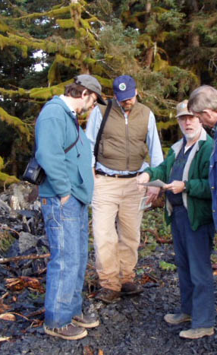
coordination
DOF coordinates interagency inspections. An agency may ask DOF to schedule an inspection or DOF may initiate it. If re­quested, DOF shall schedule the inspection, or deny the agency's request and state the reasons for denial.
An agency may elevate a disagreement on whether to schedule an inspection.
11 AAC 95.245(a)

Slide 5
Inspection notice
If DOF determines that a field inspection is necessary to determine whether a DPO is consistent with applicable FRPA standards, DOF notifies the operator.
A notice of field inspection covers the minimum area necessary to determine compliance with FRPA and its regulations.
The operator shall inform DOF when the site will be available for an inspection.
AS 41.71.090(f)

Slide 6
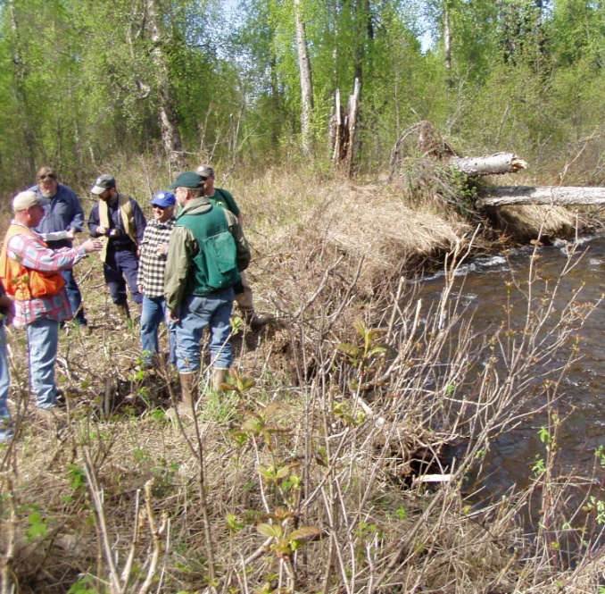
Notify Operator
DOF shall make every reasonable effort to notify the operator's representative of a pending inspection at least 5 days before the inspection and give the operator the opportunity to accompany state person­nel during the inspection.
11 AAC 95.245(c)

Slide 7
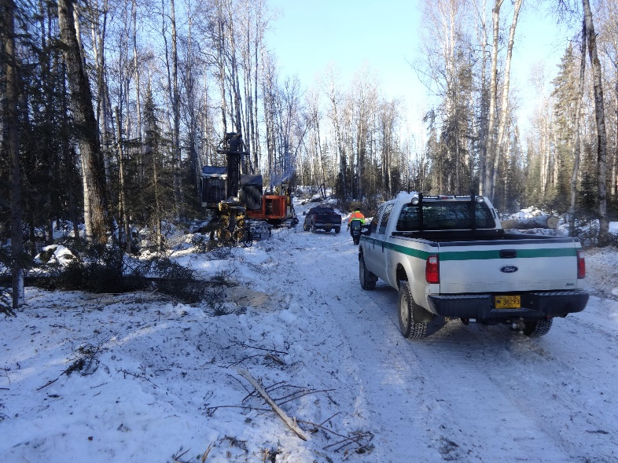
site availability
If DOF requires a field inspection, the operator shall inform DOF when the site will be available for an inspection:
accessible by mechanized means within 1 mile of the activity
free of significant snow cover, except for a winter operation
For a winter operation, the feature to be inspected must be locatable or adequately marked. 11 AAC 95.245(b)
Little Su Winter road inspection
Photo: Ed Soto, DOF

Slide 8
Inspection timing
DOF shall conduct the field inspection within 21 days after the date the site will be accessible and available unless the operator otherwise agrees.
The operator may begin operations at the conclusion of the 21‑day period unless DOF has issued a stop work order.
AS 41.71.090(f)

Slide 9
Inspection report
DOF shall prepare a written forest operation inspection report after each inspection and provide it to the operator, forest landowner, timber owner, and agencies. The forest practices forester may provide the report to the operator before leaving the site.
11 AAC 95.245(d)

Slide 10
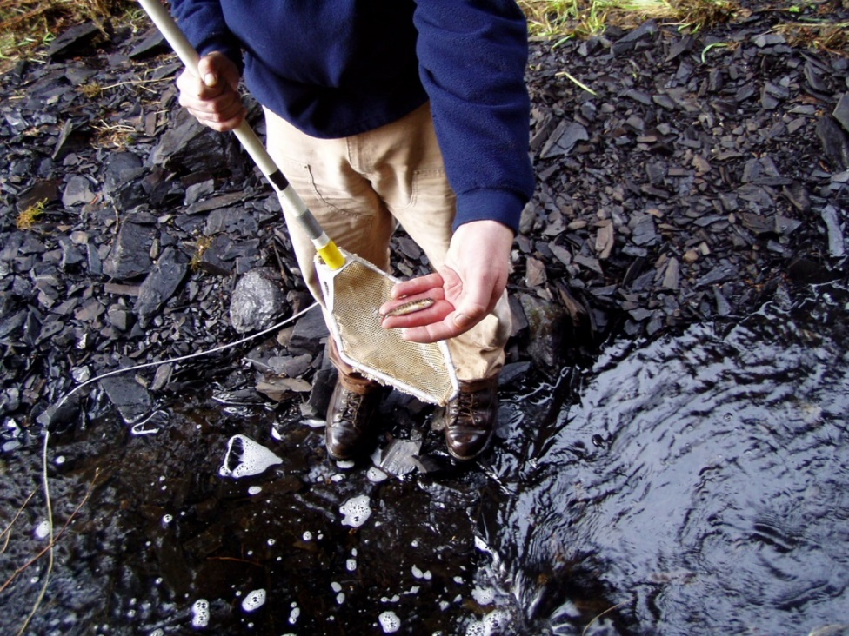
fish presence
An operator may request that ADF&G conduct an inspection to determine or verify the presence of fish in surface waters.
Requests for fish presence inspections must be included in a DPO.
11 AAC 95.220(a)(5)(D)

Slide 11
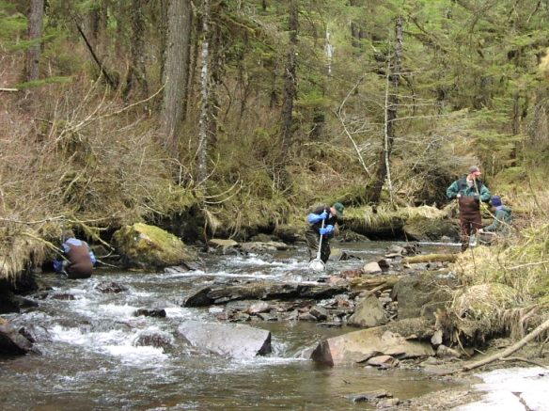
stream classification
An operator's classification of a water body type may be verified by the agencies before or during review of a DPO, and is subject to a field inspection.
See also FRPA 101-D STREAM CLASSIFICATION
11 AAC 95.265(c)

Slide 12
classification
An operator or DOF may ask ADF&G to conduct a field review to document the presence or absence of anadromous fish, and in Regions II-III, the presence or absence of high value resident fish.
Schedule a field review when evidence of anadromous fish is likely to be present and the site is accessible. This does not extend the time schedule for DPO inspections.
11 AAC 95.265(d)

Slide 13
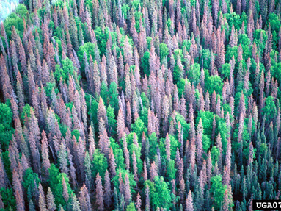
reforestation exemptions
As part of the DPO review, DOF may inspect the site of an exemption request to confirm whether the stand is significantly composed of insect and disease-killed, fire killed, wind thrown, or fatally damaged trees.
11 AAC 95.375(h)
SBB Kill on Kenai Peninsula
William M. Ciesla, Forest Health Management International, Bugwood.org

Slide 14
Compliance monitoring

Slide 15
FRPA and monitoring
The board shall coordinate the monitoring of the implementation and effectiveness of FRPA and its regulations and BMPs in meeting state water quality standards, fish and wildlife habitat requirements, and other forestry objectives.
The board reports annually to the governor […] with its recommendations for changes and for needed research and monitoring.
AS 41.17.047(d)

Slide 16
What is compliance monitoring?
Compliance monitoring assesses whether timber operations are properly implementing FRPA and its BMPs.
Effectiveness monitoring evaluates whether the BMPs successfully protect water quality and fish habitat when implemented properly.
Notes:
Photo: Haines road condition survey culvert inspection

Slide 17
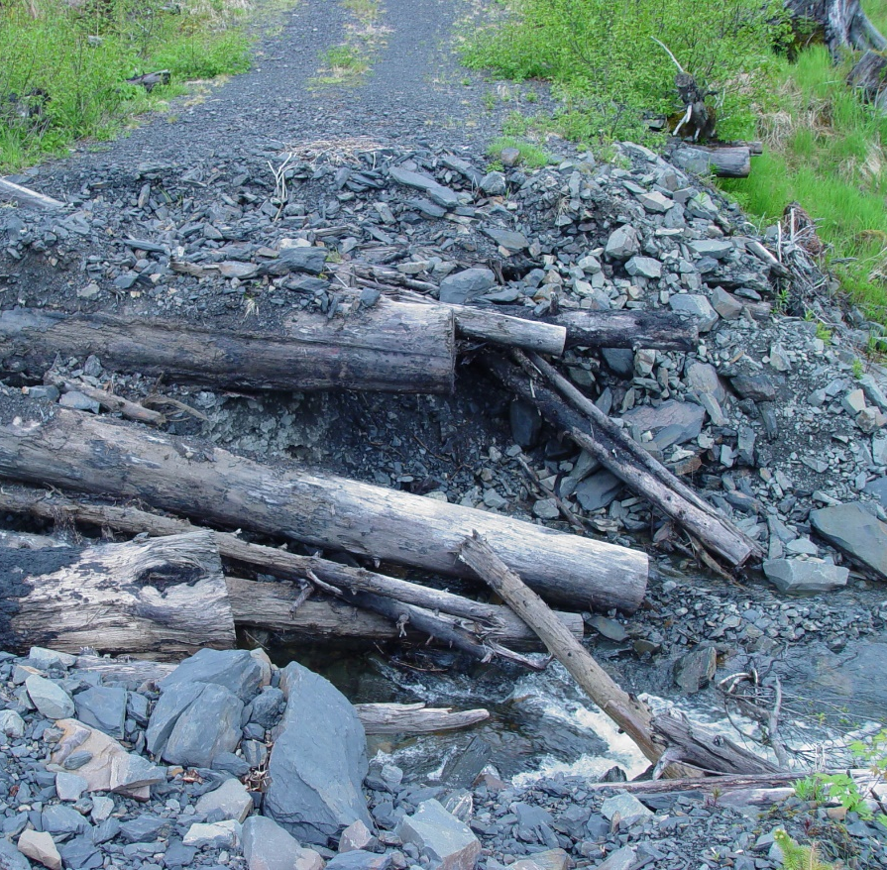
purpose
Document how frequently the operators are implementing a BMP when it applies to the harvest activity they are conducting.
Document whether operators are correctly applying the BMP.
Purple book - Introduction
Inspection of flooded road.
Photo: Wade Wahrenbrock, DOF

Slide 18
purpose
Compliance monitoring does not determine
Whether or not implementation of the BMP is necessary to protect water quality,
The effectiveness of the BMP in protecting water quality.
Purple book - Introduction
Notes:
These functions are part of effectiveness monitoring and research

Slide 19
Scope
Conduct compliance monitoring on all current timber harvest operations subject to FRPA on all land ownerships.
Coordinate compliance monitoring with FRPA inspections and state timber sale inspections.
Complete compliance score sheets on selected harvest activities during routine inspections of timber harvesting operations on all landownerships.
Purple book – Introduction

Slide 20
Procedure – coverage & planning
You do not need to need to monitor all aspects of the operation for compliance during each inspection.
Complete a score sheet on all applicable activities that you can review during your time on the ground.
Gather as many samples from as many operations as possible during the year.
Purple book - Introduction

Slide 21
Procedure – coverage & planning, cont.
Select the roads, units, and harvest activities to evaluate prior to going out in the field. Incorporate compliance monitoring into the inspection plan.
On state sales, complete all relevant sections of the score sheet to assist in sale administration.
Purple book - Introduction

Slide 22
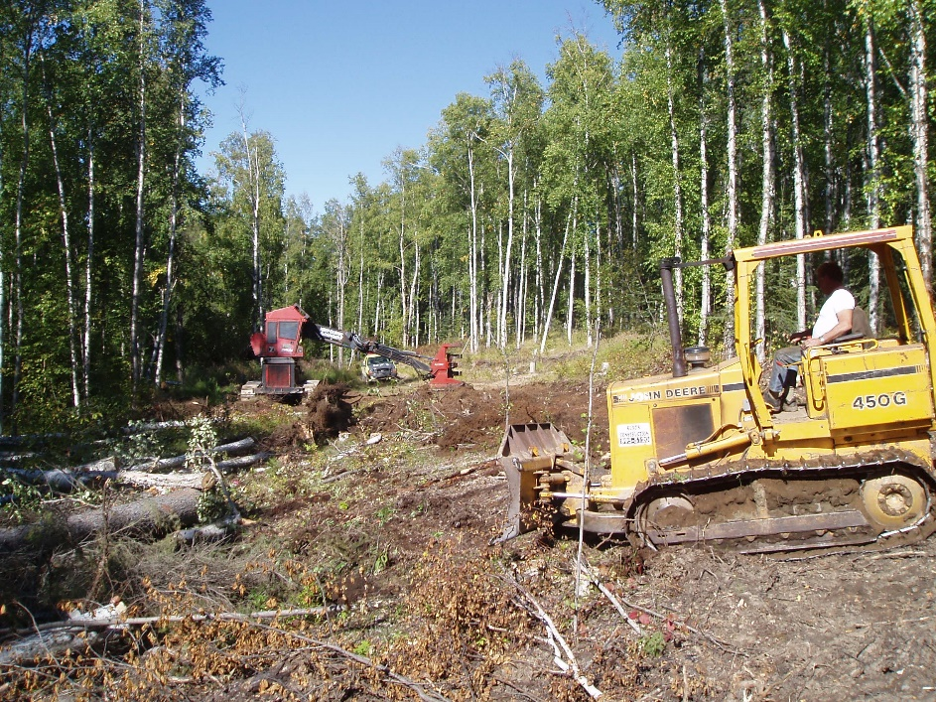
What to Monitor: New Activity
Recently completed units: Check compliance with timber harvest related BMPs.
Recently built roads: Check for compliance with road construction and road drainage BMPs.
Purple book - Introduction
Notes:
Evidence of how well the BMPs were implemented is best viewed soon after harvest has been completed when disturbances from yarding can be readily discerned.
Newly constructed roads usually have not been significantly modified by subsequent use or maintenance operations.

Slide 23
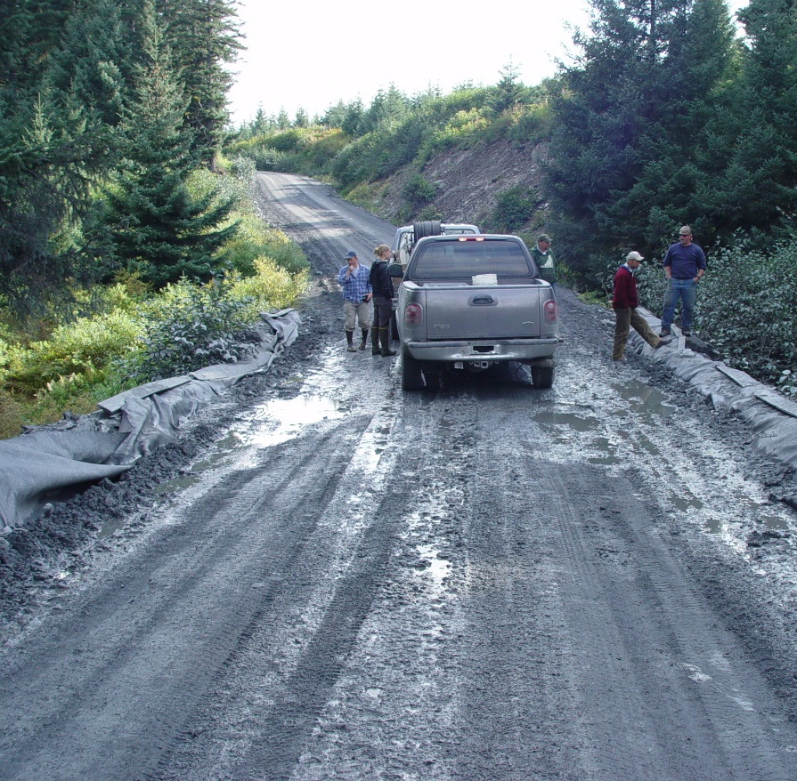
What to Monitor: Roads
Roads used for hauling during the current operating season to check for compliance with active road maintenance BMPs.
Roads not currently being used for hauling but that were used in previous seasons to check for compliance with inactive road maintenance BMPs.
Roads recently closed by the operator for compliance with road closure BMPs.
Purple book - Introduction
Notes:
Give preference to roads that were used last season.
Stay up to date with what roads the operator is planning to close that are still readily accessible and don’t require an excessive amount of time to inspect.

Slide 24
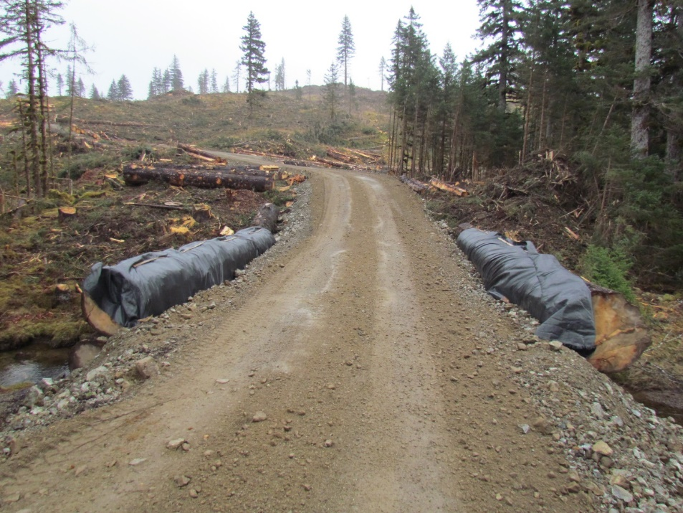
What to Monitor: crossings
Review every crossing structure over a fish stream for compliance with bridge and culvert BMP’s at least once during its active life.
Purple book – Introduction
Training Note #05-01
Notes:
Only the specific structure evaluated is considered when rating the implementation of the BMPs contained in the Crossing Structure Component.
Photo: rock-decked bridge

Slide 25
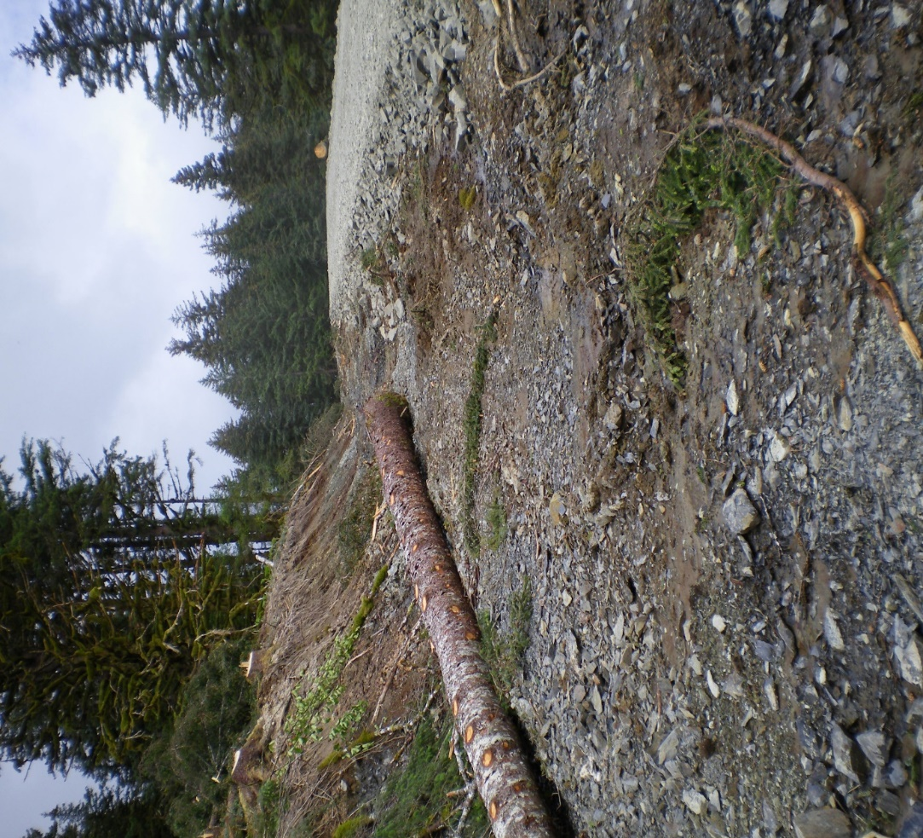
Road construction & maintenance
Rate the BMPs as they pertain to drainage features and road construction and maintenance in general along the road segment.
Training Note #05-01
Notes:
Some of the road construction and maintenance BMPs are also included in the BMPs rated for individual crossing structures on surface waters because implementation of the relevant BMPs on these structures merits special attention.
Photo comments: This is a clean ditch, silt can be seen in the foreground. Placement of rock berms in the ditch is appropriate to slow water down. Log should be removed.

Slide 26
What to Monitor: Spurs & landings
Short spurs and landings require minimal review unless they are in or adjacent to riparian areas, in which case the riparian area BMP’s are applicable.
Purple book - Introduction

Slide 27
Procedure: sizing
Keep harvest areas and road segments for scoring to a reasonable size.
For a single large unit, consider basing the monitoring on a setting within the unit.
Avoid evaluating road segments more than 2 miles long.
Purple book - Introduction
Notes:
It is harder to assess compliance and assign a score as an area increases in size or the road lengthens.
Bigger/longer rating units also favor assignment of mid-range scores, biasing the results.
As the number of times a BMP is applicable increases, variability in how well the BMP was implemented each time makes it increasingly difficult to consistently assess and score the BMP.

Slide 28
Procedure: sizing, cont.
Do not fill out a score sheet on a portion of the operation if you’re just driving through -- take the time to get out on the ground and walk the road or unit being evaluated.
Purple book - Introduction

Slide 29
Procedure: roads
When evaluating a unit, also evaluate the roads within the unit to expand the amount of monitoring conducted. Both activities can be evaluated on the same score sheet.
Purple book - Introduction

Slide 30
Procedure: roads, cont.
Consider using road junctions and changes in construction methods to define the road segment to monitor. This helps ensure the segment being assessed was built to the same standards.
Avoid ending road segments on stream crossings.
Purple book - Introduction
Training Note #05-01
Notes:
From Bruce Johnson, Training Note #05-01:
Changes is construction are things like a shift from overlay to partial or full bench techniques
Also consider notable changes in the implementation of a BMP.
It is important to include stream crossings in the monitoring.

Slide 31
Procedure: Landing spurs
Treat landing spurs as a separate road segment.
Report the segment length as 1/10 mile if it is less than that long.
The length assigned to a road segment is the nearest 1/10 mile.
Training Note #05-01
Notes:
Distance can be measured by whatever means you feel is adequate to meet this level of accuracy.

Slide 32
Procedure: Stream crossings and ADF&G
Identify in advance which roads are likely to cross fish streams. Coordinate inspection of these roads with ADF&G so fish passage measurements can be taken.
If ADF&G is not present when you evaluate a fish stream culvert, note in the comment section if the culvert is perched more than four inches at either one or both ends, or if the culvert width to channel bed-width (bottom of bank) ratio is less than 0.75.
Training Note #05-01
Notes:
Perched culvert in Region III. Photo: Chris Stark

Slide 33
Applicability
The applicability of a BMP appearing on the score sheet depends on the harvest activity being evaluated, the terrain, the location of waterbodies, and other site specific characteristics encountered in the field.
For example…
Purple book - Introduction

Slide 34
Applicability examples
BMPs covering the construction and adequacy of a drainage system are applicable whenever a road is constructed.
BMPs relating to log stringer bridges are only applicable to streams crossed by a log stringer bridge.
Riparian-related BMPs are applicable if a harvest activity is adjacent to a classified waterbody, or if a harvest activity occurs within the associated riparian area.
Purple book - Introduction

Slide 35
Applicability, cont.
A BMP applies even if there are no perceived adverse impacts to water quality resulting from the operator’s failure to implement it.
The goal of compliance monitoring is to determine if the operators are consistently implementing the BMPs.
Purple book - Introduction

Slide 36
scoring

Slide 37
Scoring QUESTIONS
Scores are based on answers to the following questions:
Is the BMP applicable to the harvest activity?
Did the operator implement it?
How frequently did the operator implement it?
How well was the BMP implemented?
Purple book - Introduction

Slide 38
Typical scoring characteristics
Score | BMP was implemented when applicable… | BMP was implemented in a manner that was…
1 | Rarely | Ineffective
2 | Occasionally | Marginally effective
3 | Usually | Somewhat effective
4 | Frequently | Generally effective
5 | Consistently | Effective

Slide 39
“not applicable”
Score a BMP “not applicable” (N/A) when
It was not applicable to the harvest activity assessed.
it can not be implemented because the operator failed to implement a prior BMP.
Purple book - Introduction

Slide 40
BASIS OF SCORE
Score the BMP using the characteristic that has the lowest performance by the operator. For example:
The operator frequently implemented the BMP when it was applicable but the way in which it was applied was only somewhat effective in achieving the desired result. In this instance the BMP would be scored as a three (3).
Purple book - Introduction

Slide 41
Scoring CONNECTIONS
It is easier to distinguish between the implementation of a BMP and how effectively it was applied for some BMPs than for others.
For example:
Installation of a cross drain or relief culvert that is angled down grade and out sloped will provide more effective drainage than one that is installed straight across the road.
Purple book - Introduction

Slide 42
examples, cont.
Runoff may not enter a cross drain with a perched inlet at low flows unless a ditch block is also installed. Together they are more effective in providing the required drainage.
Sediment generated from erosion of excess road overburden excavated from within a riparian area that is deposited outside the riparian area but on the side of a ridge facing the stream is more likely to enter the stream than if it was placed on the back side of the same ridge.
Purple book - Introduction

Slide 43
prior failures
For the same activity, don’t rate an operation for failure to implement a maintenance-related BMP if the problem is due to the operator’s failure to perform an applicable construction related BMP. Examples:
Failing to maintain a functional/clear ditchline under 315(b)(1) or 315(c)(3) because the operator failed to install the ditchline required by 295(d).
Failing to prevent grading material off a rock-decked bridge required by 315(b)(6) if the operator failed to install the curb log required by 300(a)(4).
Training note 05-01
Notes:
.315(b)(1) – Keep culverts and ditches functional
.315(c)(3) – Keep drainage structures clear and in good repair
.295(d) – Outsloping and ditching roads
.315(b)(6) – Grading rock-decked bridges
.300(a)(4) – Install curbs and filter fabric on rock-decked bridges.

Slide 44
implementation by default
Don’t give credit for implementation of a BMP by default. For example:
Credit for implementing .295(f) on a surface water crossing structure due to the operator’s failure to provide a ditch-line as required by .295(d).
Credit for implementing .280(d)(5) if there was no need to excavate material within the riparian area.
Credit for implementing .295(d) if no ditchline is required.
Training note #05-01
Notes:
,295(f) - Divert ditch-line runoff away from surface waters
.280(d)(5) – Sidecasting material in riparian areas
.295(d) – Roads outsloped or ditched on uphill side

Slide 45
Operation Name: |  |  |  |  |  |  | Forester's name and Area Office:
Notification Number: |  |  |  |  |  |  | Date: |  |  |  |  |  |  |  |  |  | Land Owner:
Unit #: |  |  | Road #: |  |  |  | Road Class: |  |  |  | A I C (circle one) |  |  |  |  |  | Operator:
Agency Presence: ADFG DEC (circle if applicable)
 |  |  |  |  |  |  |  |  | Rating |  |  |  |  |  |  |  |  |  |  |  |  |  |  | Rating
BMP |  |  |  |  |  |  | 5 | 4 | 3 | 2 | 1 | n.a. |  |  | BMP |  |  |  |  |  |  | 5 | 4 | 3 | 2 | 1 | n.a.
 | GENERAL |  |  |  |  |  |  |  |  |  |  |  |  |  |  | BRIDGES
815b | Disposal of Petroleum Products |  |  |  |  |  |  |  |  |  |  |  |  |  | 300a1 | Install Relief Culverts on Approaches
815b | Disposal of Scrap Metal |  |  |  |  |  |  |  |  |  |  |  |  |  | 300a2 | Anchor One End of Log Bridge
 | RIPARIAN AREAS |  |  |  |  |  |  |  |  |  |  |  |  |  | 300a3 | Protect Earth Embankment from Erosion
265 | Classification of Surface Water Bodies |  |  |  |  |  |  |  |  |  |  |  |  |  | 300a4 | Install Curbs & Filter Fabric
280d5 | Sidecasting Material in Riparian Areas |  |  |  |  |  |  |  |  |  |  |  |  |  | 300a8 | Min. Distrubance to Bed & Bank of Stream
285b | Locating Roads in Riparian Areas |  |  |  |  |  |  |  |  |  |  |  |  |  | 300d | Do Not Enchroach on Fish Stream
350c | Leaving High Stumps in Riparian Areas |  |  |  |  |  |  |  |  |  |  |  |  |  |  | CULVERTS
355e1 | Falling Trees into Retention Areas |  |  |  |  |  |  |  |  |  |  |  |  |  | 305a3 | Culvert is not Perched
360c4 | Cable Yarding Adjacent to Riparian Areas |  |  |  |  |  |  |  |  |  |  |  |  |  | 305a4 | Culvert Terminates on Non-erodible Material
365b | Ground Skidding in Riparian Areas |  |  |  |  |  |  |  |  |  |  |  |  |  | 305a7 | Clear of Mobil Slash
 | TIMBER HARVESTING |  |  |  |  |  |  |  |  |  |  |  |  |  | 305a8 | Catch Basins and Headwalls
345a,b | Landing Location, Construction, & Operation |  |  |  |  |  |  |  |  |  |  |  |  |  | 305a9 | Culverts are Proper Length
350a | Min. Disturbance Adjacent to Surface Waters |  |  |  |  |  |  |  |  |  |  |  |  |  |  | ROAD MAINTENANCE
350b | Avoid Disturbing LWD in Surface Waters |  |  |  |  |  |  |  |  |  |  |  |  |  |  | ACTIVE ROADS
355c | Removal of Trees from Surface Waters |  |  |  |  |  |  |  |  |  |  |  |  |  | 315b1 | Culverts Functional
355d | Bucking of Trees in Surface Waters |  |  |  |  |  |  |  |  |  |  |  |  |  | 315b1 | Ditches Functional
360a,b | Cable Yarding Adjacent to Surface Waters |  |  |  |  |  |  |  |  |  |  |  |  |  | 315b4 | Roads Crowned or Outsloped
360c1-3 | Obtaining Deflection when Cable Yarding |  |  |  |  |  |  |  |  |  |  |  |  |  | 315b4 | Shoulders Free of Berms
365f | Proper Skidding Techniques Followed |  |  |  |  |  |  |  |  |  |  |  |  |  | 315b5,6 | Grading Bridges
365g | Stabilizing & Water Barring Skid Trails |  |  |  |  |  |  | ` |  |  |  |  |  |  |  | INACTIVE ROADS
 | ROAD CONSTRUCTION |  |  |  |  |  |  |  |  |  |  |  |  |  | 315c2 | Surface Not Conducive to Erosion
290c | Erosion Controls on Unstable Soils |  |  |  |  |  |  |  |  |  |  |  |  |  | 315c3 | Drainages Structures Clear
290d | End Haul of Waste Material |  |  |  |  |  |  |  |  |  |  |  |  |  | 315c3 | Ditches Clear
290e | Fall Away from All Surface Waters |  |  |  |  |  |  |  |  |  |  |  |  |  |  | CLOSED ROADS (POST 1993)
290j | Disposal of Material in Suitable Sites |  |  |  |  |  |  |  |  |  |  |  |  |  | 320b1 | Road Condition Suitable to Control Erosion
 | DRAINAGE |  |  |  |  |  |  |  |  |  |  |  |  |  | 320b2 | Ditches Suitable to Reduce Erosion
295b | Adequate Number of Drainage Structures |  |  |  |  |  |  |  |  |  |  |  |  |  | 320b4,c | Structures & Fills Removed from Surface Waters
295b | Drainage Structures on all Natural Drainages
295d | Roads Outsloped or Ditched on Uphill Side |  |  |  |  |  |  |  |  |  |  |  |  |  | Score
295f | Relieve Ditches Away from Surface Waters |  |  |  |  |  |  |  |  |  |  |  |  |  | Sum # Boxes Checked x Each Rating / 245 - (#n.a. x 5) |  |  |  |  |  |  |  |  |  |  | %
295i | Do Not Discharge onto Unprotected Slopes
Region I
Notes:
Score sheet template – Region I

Slide 46
Operation Name: |  |  |  |  |  |  | Forester's name and Area Office:
Notification Number: |  |  |  |  |  |  | Date: |  |  |  |  |  |  |  |  |  | Land Owner:
Unit #: |  |  | Road #: |  |  |  | Road Class: |  |  |  | A I C |  |  | (circle one) |  |  | Operator:
Agency Presence: ADFG DEC (circle if applicable)
 |  |  |  |  |  |  |  |  | Rating |  |  |  |  |  |  |  |  |  |  |  |  |  |  | Rating
BMP |  |  |  |  |  |  | 5 | 4 | 3 | 2 | 1 | n.a. |  |  | BMP |  |  |  |  |  |  | 5 | 4 | 3 | 2 | 1 | n.a.
 | GENERAL |  |  |  |  |  |  |  |  |  |  |  |  |  |  | BRIDGES
815b | Disposal of Petroleum Products |  |  |  |  |  |  |  |  |  |  |  |  |  | 300a1 | Install Relief Culverts on Approaches
815b | Disposal of Scrap Metal |  |  |  |  |  |  |  |  |  |  |  |  |  | 300a3 | Protect Earth Embankment from Erosion
 |  |  |  |  |  |  |  |  |  |  |  |  |  |  | 300a4 | Install Curbs & Filter Fabric
 | RIPARIAN AREAS |  |  |  |  |  |  |  |  |  |  |  |  |  | 300a5 | Construction of Ice Bridges
280d5 | Sidecasting Material in Riparian Areas |  |  |  |  |  |  |  |  |  |  |  |  |  | 300a8 | Min. Disturbance to Bed & Bank of Stream
285b | Locating Roads in Riparian Areas |  |  |  |  |  |  |  |  |  |  |  |  |  | 300d | Do Not Enchroach on Fish Stream
355e1 | Falling Trees into Retension Areas |  |  |  |  |  |  |  |  |  |  |  |  |  |  | CULVERTS
365b | Ground Skidding in Riparian Areas |  |  |  |  |  |  |  |  |  |  |  |  |  | 305a3 | Culvert is not Perched
 | TIMBER HARVESTING |  |  |  |  |  |  |  |  |  |  |  |  |  | 305a4 | Culvert Terminates on Non-erodible Material
345a,b | Landing Location, Construction, & Operation |  |  |  |  |  |  |  |  |  |  |  |  |  | 305a7 | Clear of Mobil Slash
350a | Min. Disturbance Adjacent to Surface Waters |  |  |  |  |  |  |  |  |  |  |  |  |  | 305a8 | Catch Basins and Headwalls
355c | Removal of Trees from Surface Waters |  |  |  |  |  |  |  |  |  |  |  |  |  | 305a9 | Culverts are Proper Length
355d | Bucking of Trees in Surface Waters |  |  |  |  |  |  |  |  |  |  |  |  |  |  | ROAD MAINTENANCE
365c | Remove Debris from Frozen Surface Waters |  |  |  |  |  |  |  |  |  |  |  |  |  |  | ACTIVE ROADS
365f | Proper Skidding Techniques Followed |  |  |  |  |  |  |  |  |  |  |  |  |  | 315b1 | Culverts Functional
365g | Stabilizing & Water Barring Skid Trails |  |  |  |  |  |  |  |  |  |  |  |  |  | 315b1 | Ditches Functional
 |  |  |  |  |  |  |  |  |  |  |  |  |  |  | 315b4 | Roads Crowned or Outsloped
 | ROAD CONSTRUCTION |  |  |  |  |  |  |  |  |  |  |  |  |  | 315b4 | Shoulders Free of Berms
290c | Erosion Controls on Unstable Soils |  |  |  |  |  |  |  |  |  |  |  |  |  | 315b5,6 | Grading Bridges
290d | End Haul of Waste Material |  |  |  |  |  |  | ` |  |  |  |  |  |  |  | INACTIVE ROADS
290e | Fall Away from All Surface Waters |  |  |  |  |  |  |  |  |  |  |  |  |  | 315c2 | Surface Not Conducive to Erosion
290f | Winter Road Construction & WQ |  |  |  |  |  |  |  |  |  |  |  |  |  | 315c3 | Drainages Structures Clear
290h | Winter Road Construction on Public Land |  |  |  |  |  |  |  |  |  |  |  |  |  | 315c3 | Ditches Clear
290j | Disposal of Material in Suitable Sites |  |  |  |  |  |  |  |  |  |  |  |  |  |  | CLOSED ROADS (POST 1993)
 | DRAINAGE |  |  |  |  |  |  |  |  |  |  |  |  |  | 320b1 | Road Condition Suitable to Control Erosion
295b | Adequate Number of Drainage Structures |  |  |  |  |  |  |  |  |  |  |  |  |  | 320b2 | Ditches Suitable to Reduce Erosion
295b | Drainage Structures on all Natural Drainages |  |  |  |  |  |  |  |  |  |  |  |  |  | 320b4,c | Structures & Fills Removed from Surface Waters
295d | Roads Outsloped or Ditched on Uphill Side
295f | Relieve Ditches Away from Surface Waters |  |  |  |  |  |  |  |  |  |  |  |  |  | Score
295i | Do Not Discharge onto Unprotected Slopes |  |  |  |  |  |  |  |  |  |  |  |  |  | Sum # Boxes Checked x Each Rating / 230 - (#n.a. x 5) |  |  |  |  |  |  |  |  |  |  | %
Regions II-III
Notes:
Score sheet template – Regions II-III

Slide 47
Submit scoresheets
Submit copies of all completed Compliance Monitoring Score Sheets and the corresponding Field Inspection Reports to the Training Officer.
Purple book - Introduction
Notes:
Joel Nudelman is the current Training Officer

Slide 48
comments

Slide 49
Comments
Comments help the inspector prepare the associated inspection report and give reviewers insight into what is affecting implementation of the BMP.
Note which BMPs were not applicable because the operator failed to implement a prior BMP.
Note the reason for rating any BMP a 1, 2, or 3. Was the BMP infrequently implemented? Was the BMP poorly or partially executed?
Purple book - Introduction

Slide 50
examples
Ditch blocks are installed on only 2 of 5 relief culverts.
Ditch blocks are inadequate to direct ditchline flows into relief culverts and prevent overwhelming the capacity of the ditchline.
Drainages were clean of debris for only 20 feet above culvert inlets. Small debris is partially blocking culvert inlets.
The operator failed to split on the stream. Slash and debris are partially blocking the stream channel.
Purple book - Introduction

Slide 51
examples, cont.
Note any observation about the effectiveness of a BMP for future monitoring. Did implementation of the BMP achieve the desired result?
Purple book - Introduction
Notes:
E.g.,
Erodible soils were grass seeded but the grass failed to become established. Slopes continue to erode.
Ditchline flows are eroding the toe of a cut slope, causing the slope to continue sloughing. Additional drainage is required to divert runoff away from the toe of the slope.
Unable to keep fly rock out of anadromous fish stream when conducting approved blasting along approach to stream crossing.

Slide 52
Specific bmp issues

Slide 53
Mitigation ratings
Remember four of the BMPs require that a mitigation rating be assigned if sediment or erosion isn’t prevented or minimized. I’ve shaded which ones these are on the revised monitoring form.
If degradation of water quality is likely due to the failure to implement a BMP, rate the BMP for mitigation that is the primary cause, or those that are significantly contributing to creating the problem observed. Don’t rate a BMP for mitigation if the need for mitigation is created by the failure to implement another BMP.
Training Note #05-01

Slide 54
Ditchline runoff: .295(f)
When rating .295(f) under the RC&M component only, consider diverting ditch-line water away from unstable soils and non-surface waters that drain directly into surface waters (i.e. waters that would essentially serve as a continuation of the ditch-line).
The implementation of .295(f) on surface water crossings is considered separately from the rest of the road segment to avoid double dinging the operator for the same failure to implement.
Training Note #05-01
Notes:
RC&M = Road construction and maintenance
.295(f) = Diversion of ditch-line runoff away from surface waters

Slide 55
Ditchline runoff: .295(f), cont.
The standard for implementing .295(f) is to divert ditch-line water to the extent feasible.
“Feasible” means “capable of being accomplished in a successful manner within a reasonable period of time, taking into account economic, environmental, technical, and safety factors.
11 AAC 95.900(29)
Notes:
From Bruce Johnson in Training Note #05-01:
In the field I sense the tendency to substitute “reasonable” for “feasible” as the standard. I don’t believe this will correctly evaluate implementation of the BMP. If you believe what the operator did was “reasonable” please comment on it.

Slide 56
Drainage structures on natural drainages: .295(b)
Under the RC&M component, the rating for .295(b) is based on the rater’s professional judgement about the adequacy of the drainage features along the road segment. It is not based on a numerical formula.
The impact of inadequate structures installed on surface waters may be considered when rating this BMP.
If drainage features are inadequate and are rated “Not Implemented” due to serious erosion problems, the BMP should also be rated as requiring mitigation.
Training Note #05-01
Notes:
.295(b) – Drainage structures installed on natural drainages.
From Bruce Johnson in Training Note #05-01:
A mitigation rating is required regardless of whether or not the rater believes the activity is degrading water quality. The tougher standard of minimizing erosion is the required standard in this instance.
Please write a comment if mitigation is noted solely due to erosion if you believe there is no degradation of water quality.

Slide 57
Side-casting material in riparian areas: .280(d)(5)
The term “material” does not include woody debris or slash.
Do not downgrade the implementation of .280(d)(5) for deposition of this debris within a riparian area.
Do comment on it if present.
Training Note #05-01

